Slide 1
Data Science Project
Jeffrey Cain
Brandon Fisher

Slide 2
Project Overview
Seattle Checkouts Data 6.48GB
Goal: Examine the influence a best selling book has on an author’s other books
Tools: Google Cloud, Pyspark, Notepad++, Liquid Studio, Tableau

Slide 3
Methodology & Process
Dealing with Big Data
6.4 GB csv file too large to open in Notepad++ or Excel
Liquid Studio XML - large file viewer
Created small version for testing (1000 rows)
Commas in values in csv file → converted to tsv format
Processing
Mapping: x.split(“\t”)
Set Checkouts as key
Filtered:
BOOKS, not AUDIOBOOKS
Separate by Year
sortByKey(False)
take(10)

Slide 4
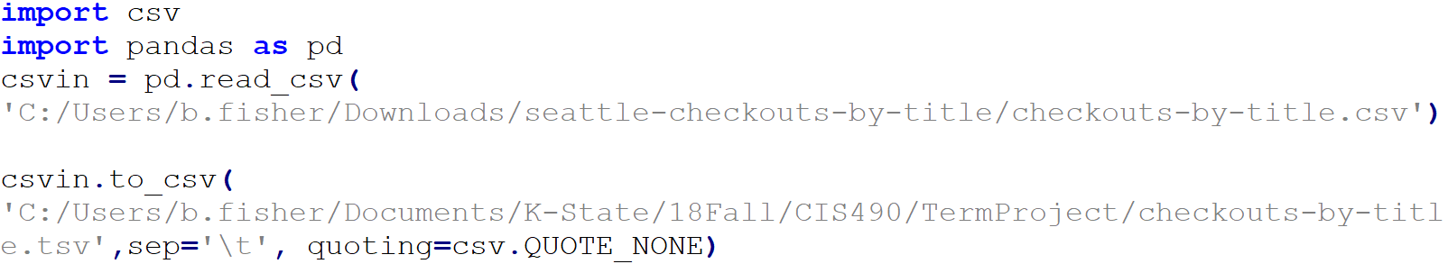
Data Organization

Slide 5
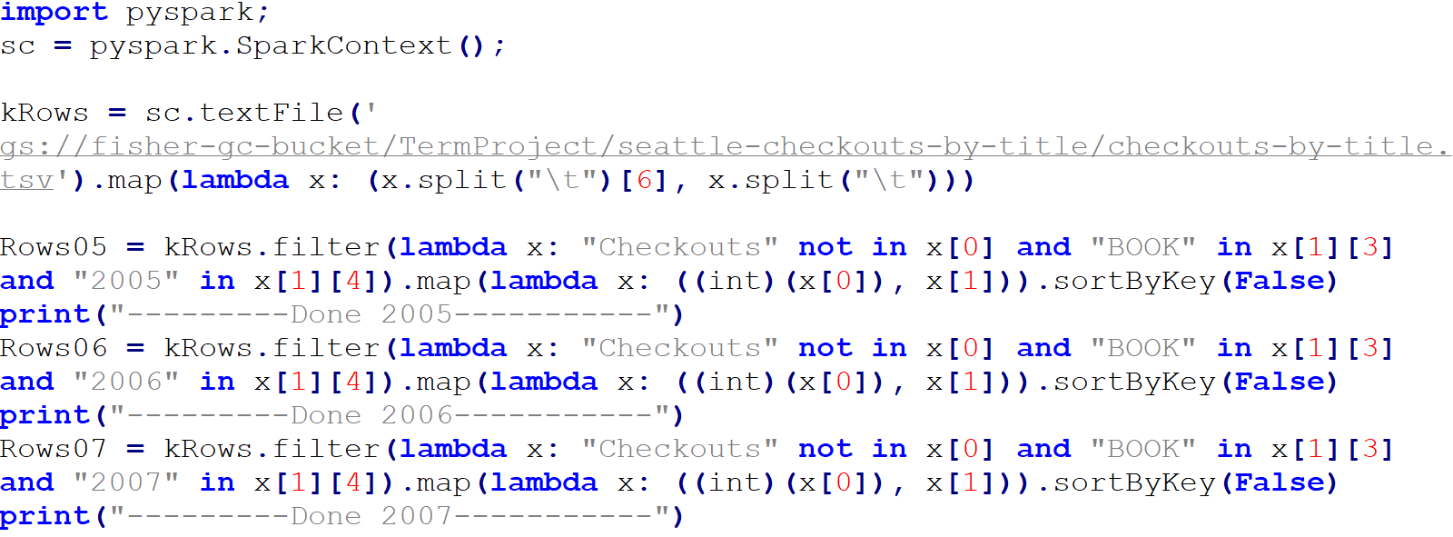
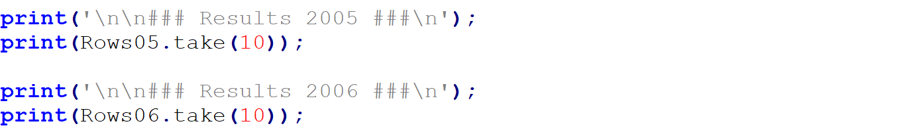
Processing

Slide 6
Methodology & Process
Analysis
Map: start same as before
Filter:
Specific Title, Author, Years
Map:
Key = Year, Month
Value = Checkouts
reduceByKey(add)
sortByKey()
Visualization
Transform data into a csv file
Join 2 files of data on their Keys
Create a graph of the data points in Tableau
Insert interesting events onto the graph timeline

Slide 7
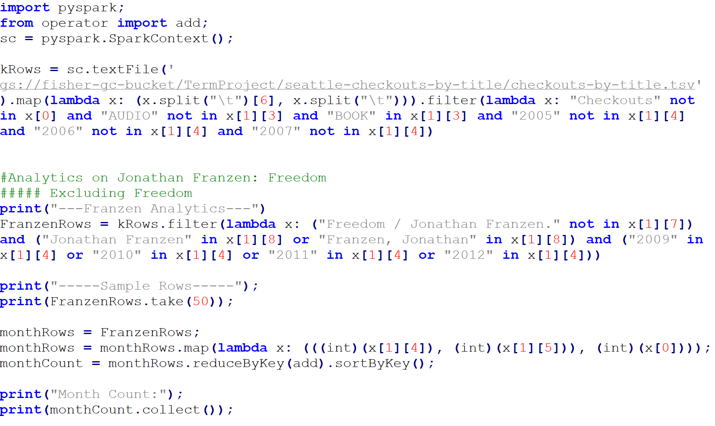
Analysis

Slide 8
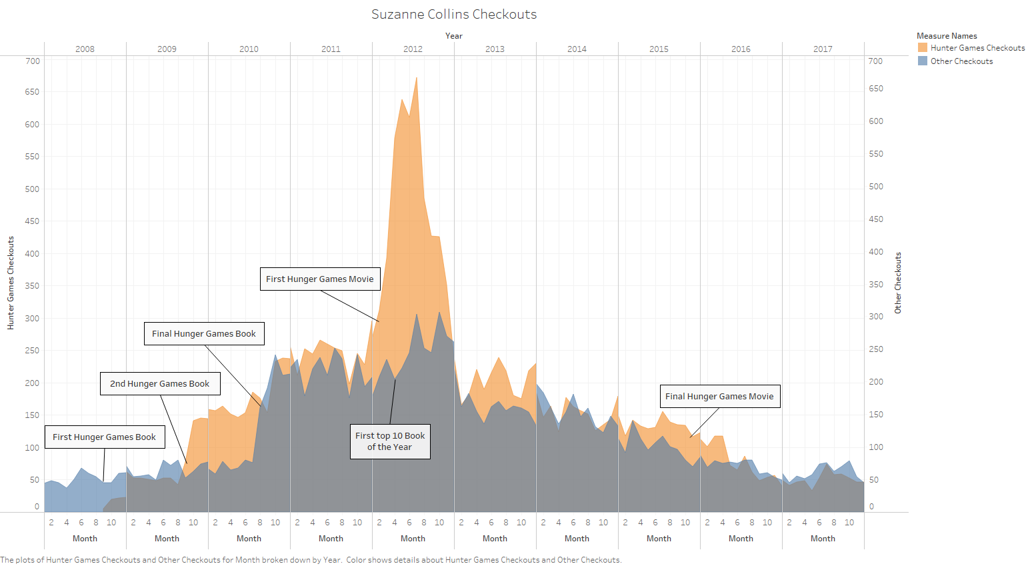
Suzanne Collins

Slide 9
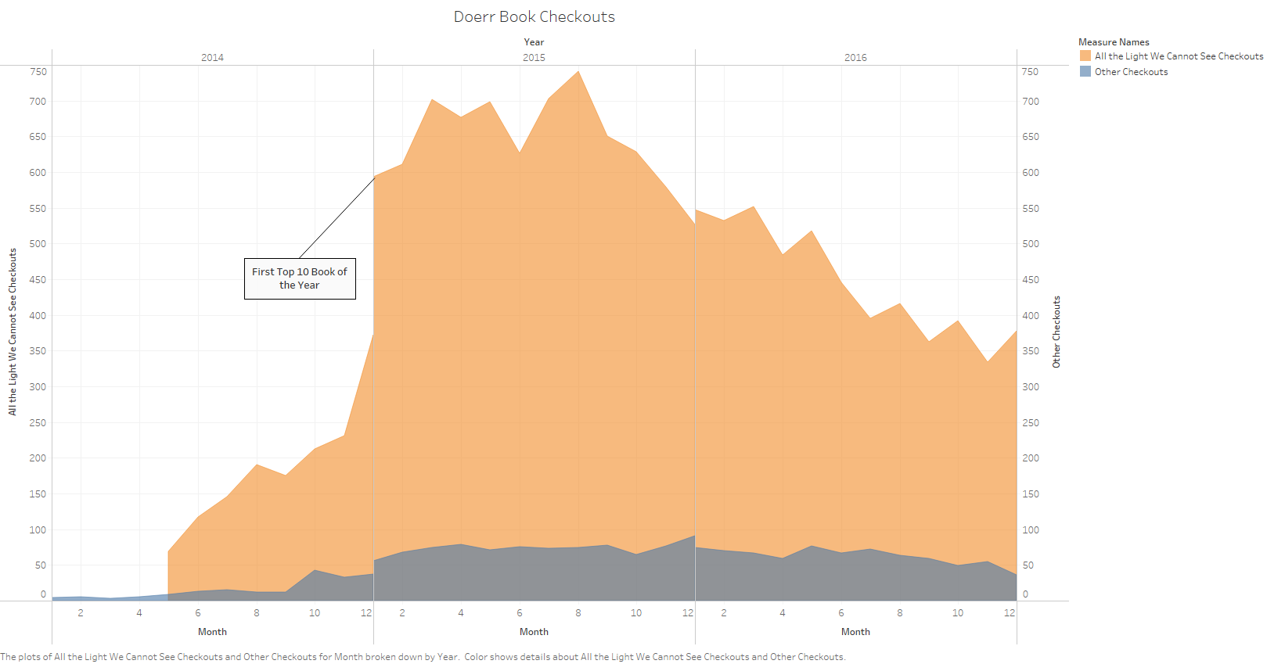
Anthony Doerr

Slide 10
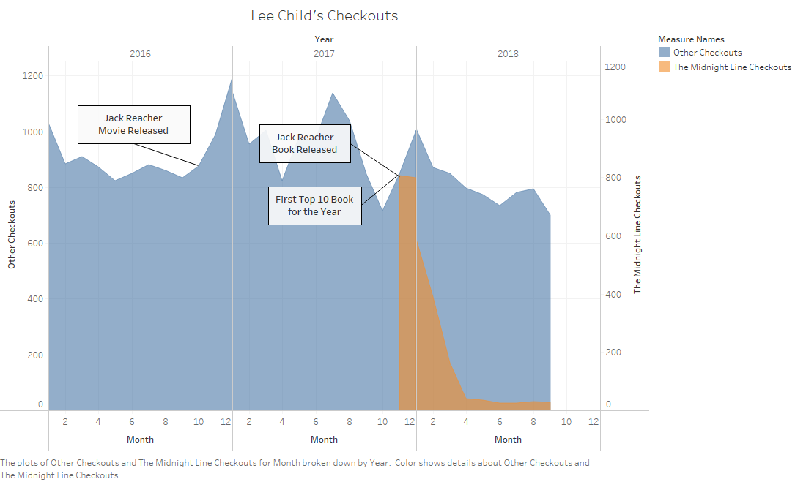
Lee Child

Slide 11
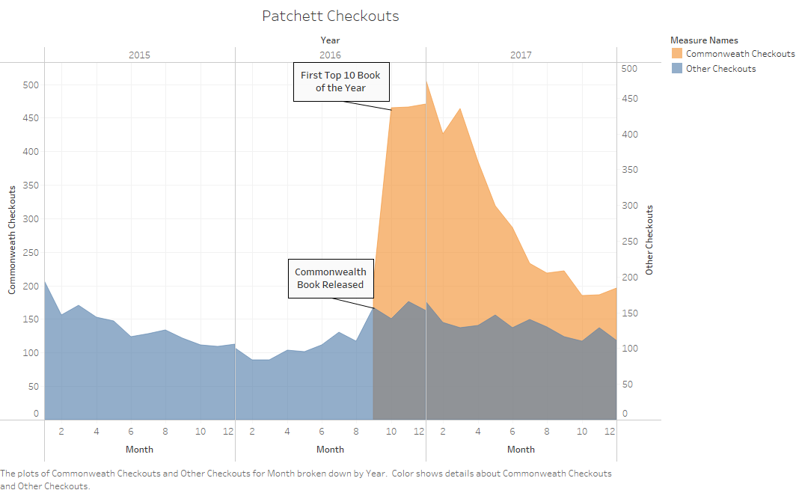
Ann Patchett

Slide 12
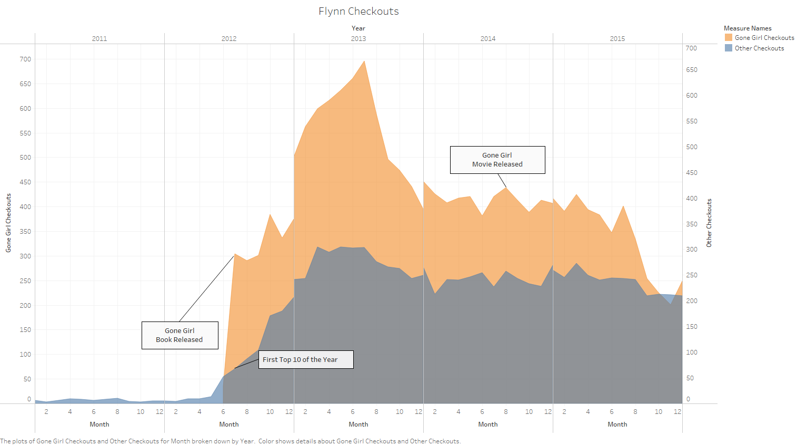
Gillian Flynn

Slide 13
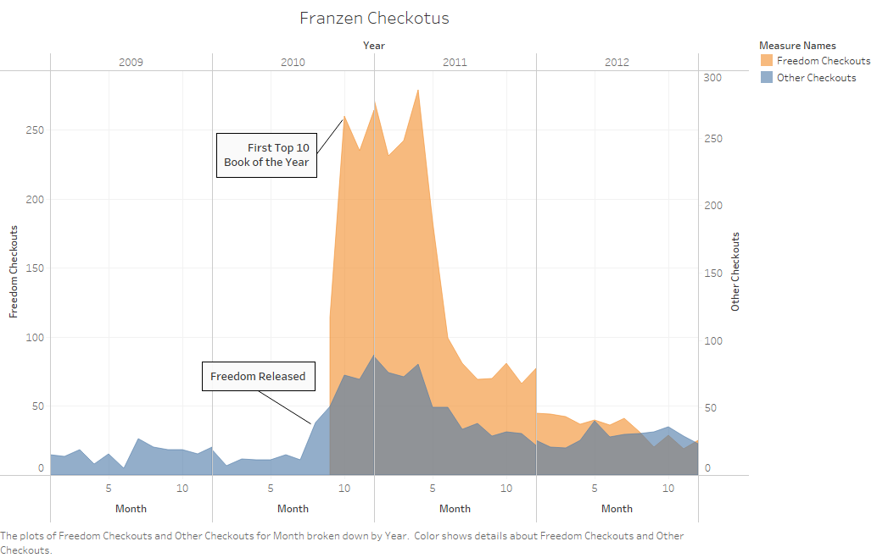
Jonathan Franzen

Slide 14
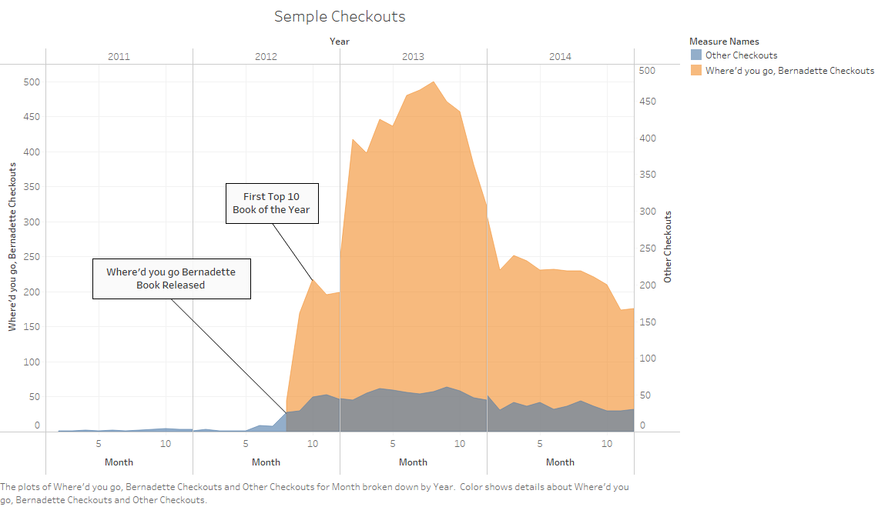
Maria Semple

Slide 15
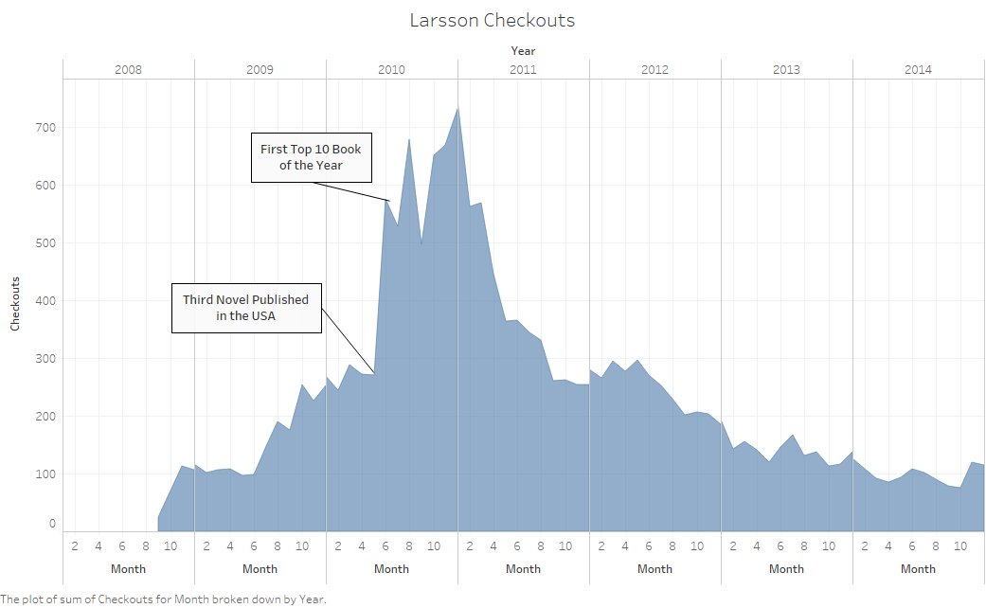
Stieg Larsson

